Slide 1
City BuDGET
TEAM F
Recording Link

Slide 2
TEAM
GAURAVDEEP SINGH BINDRA
HAOKUN WU
NAIMA ABRAR
MARIA SOFIA MERCADO AREVALO
JASON KWAN
ALEX BAPTISTA

Slide 3
Main project tasks completed
Showcased how Boston city (Operating and Capital) budget is distributed across Cabinets, Departments and Geography
Portrayed how it has changed over time
Providing valuable insights that can help the stakeholders make decisions

Slide 4
Extension projects chosen
Understanding how Boston’s Revenue is distributed across cabinets across years and also explore the Revenue has on the budget allocated
Comparing Boston’s budget distribution with Philadelphia
Explore potential correlations between budget allocation and socio-economic factors

Slide 5
DATA WORKED ON
BOSTON REVENUE(2021-24)
BOSTON SOCIO ECONOMIC DATA(2015-19)
PHILADELPHIA BUDGET(2020-25)
PHILADELPHIA REVENUE(2020-25)

Slide 6
DATASETS

Slide 7
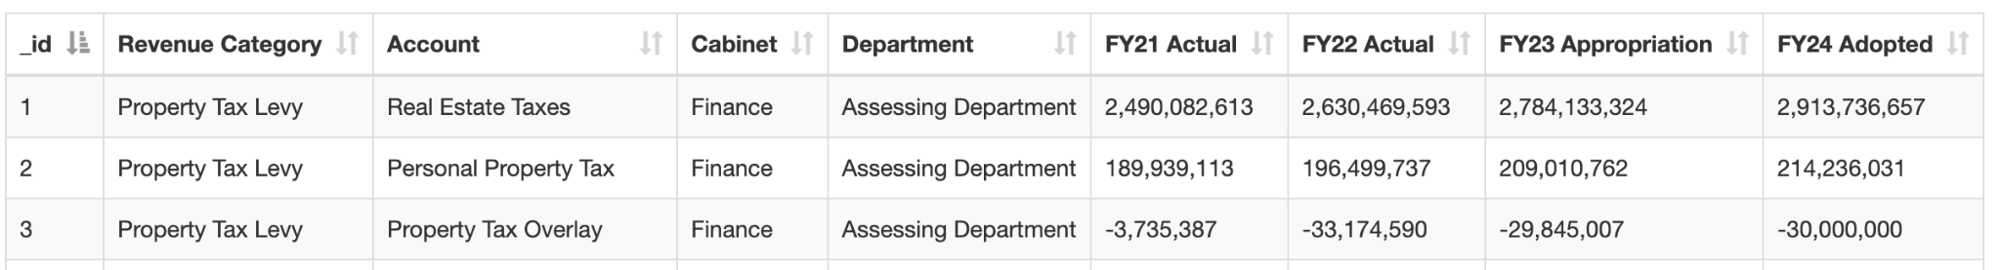
Boston revenue(2021-24)

Slide 8
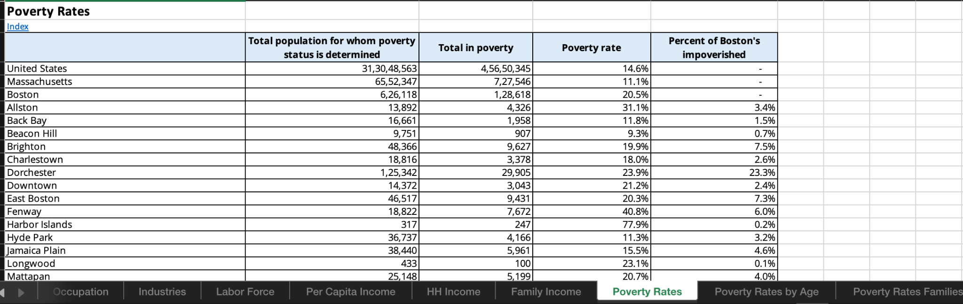
Boston socio-economic data

Slide 9
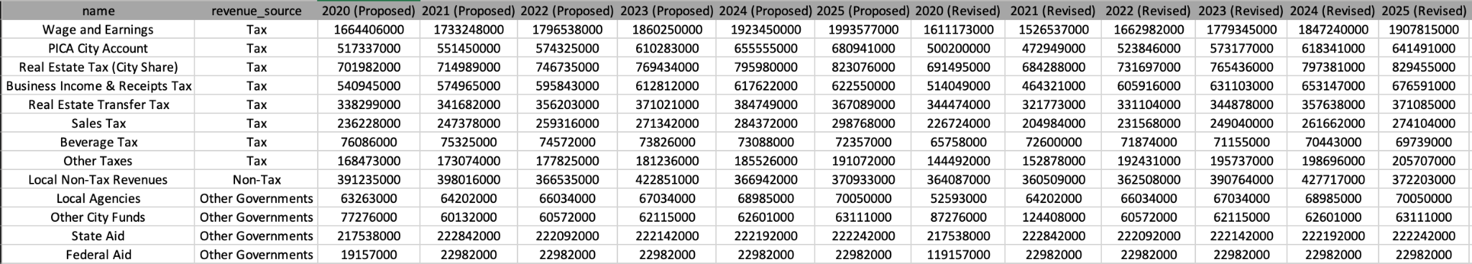
Philadelphia spending & Revenue(2020-25)
SPENDING
REVENUE

Slide 10
REVENUE ANALYSIS &
IMPACT

Slide 11
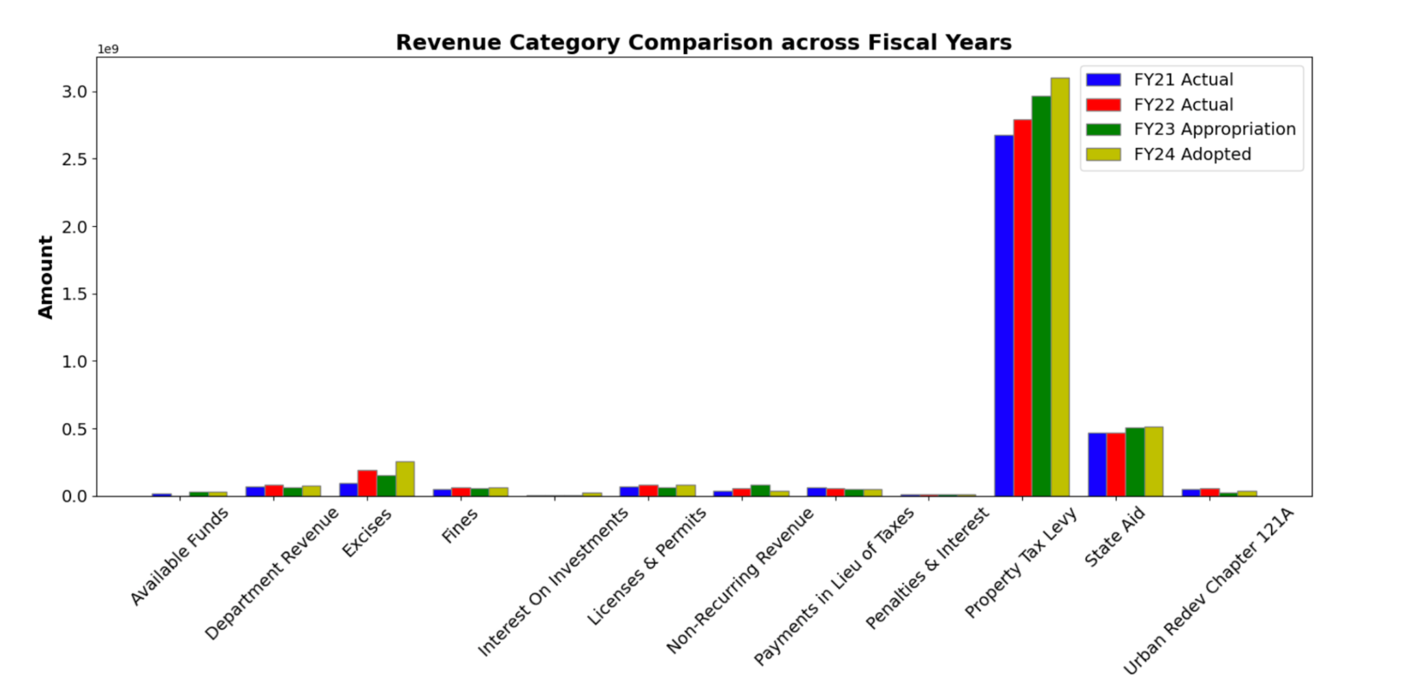
REVENUE CATEGORY COMPARISON (across fiscal years)
The "Property Tax Levy" stands out significantly, indicating its dominant role in revenue generation

Slide 12
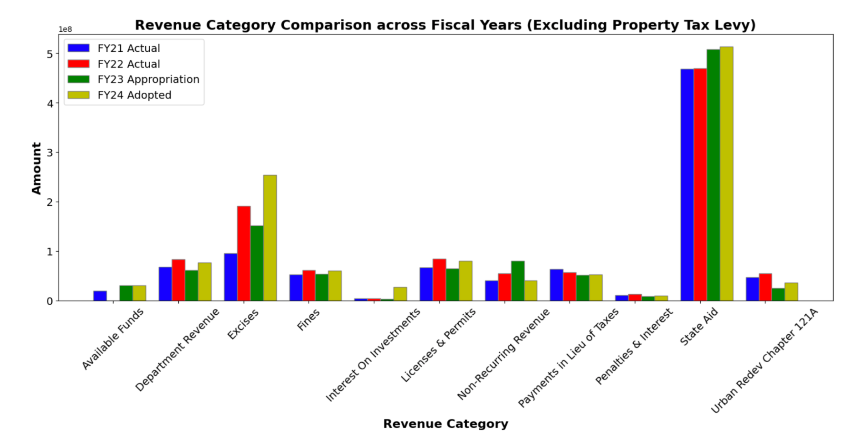
Excluding property tax
"Excises," which saw a substantial increase in the "FY24 Adopted". The majority of other revenue categories exhibit consistent trends across the years with slight fluctuations

Slide 13
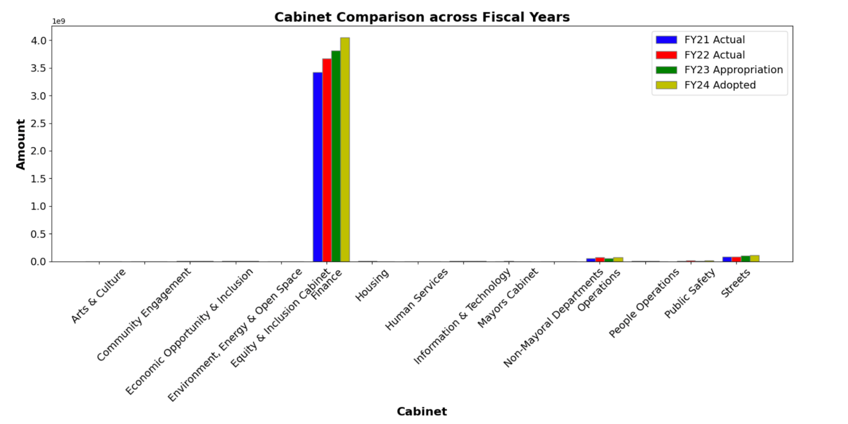
CABINET COMPARISON (across fiscal years)
Similar trend seen as was in Property Tax. Also, its clear that Property Tax category comes under ‘Finance’ Cabinet

Slide 14
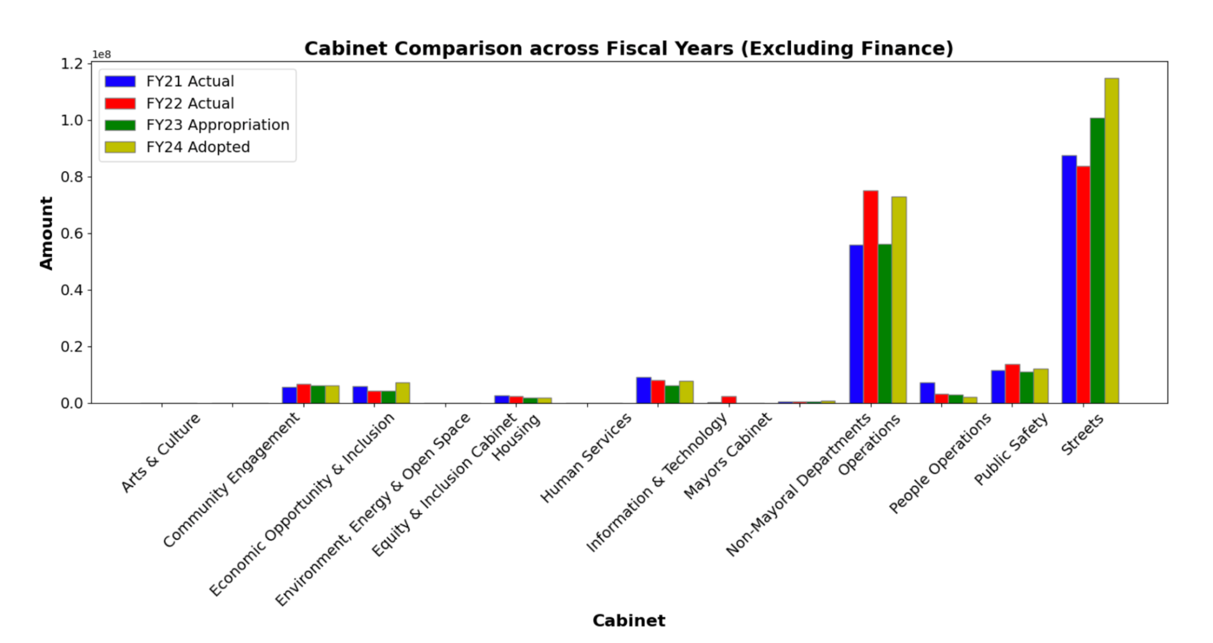
Excluding finance

Slide 15
COMPARISON WITH PHILADELPHIA

Slide 16
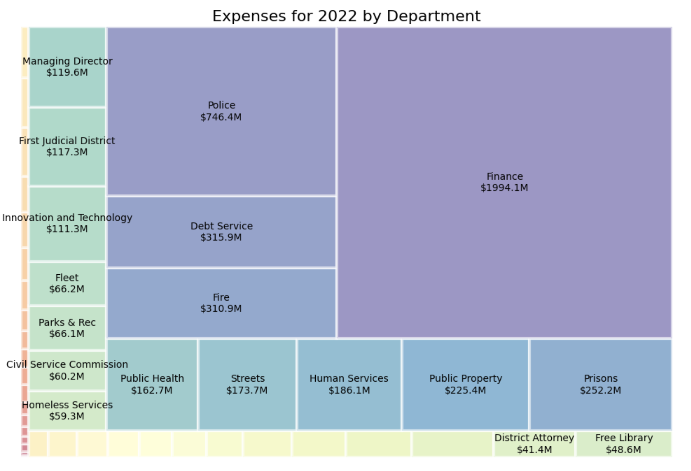
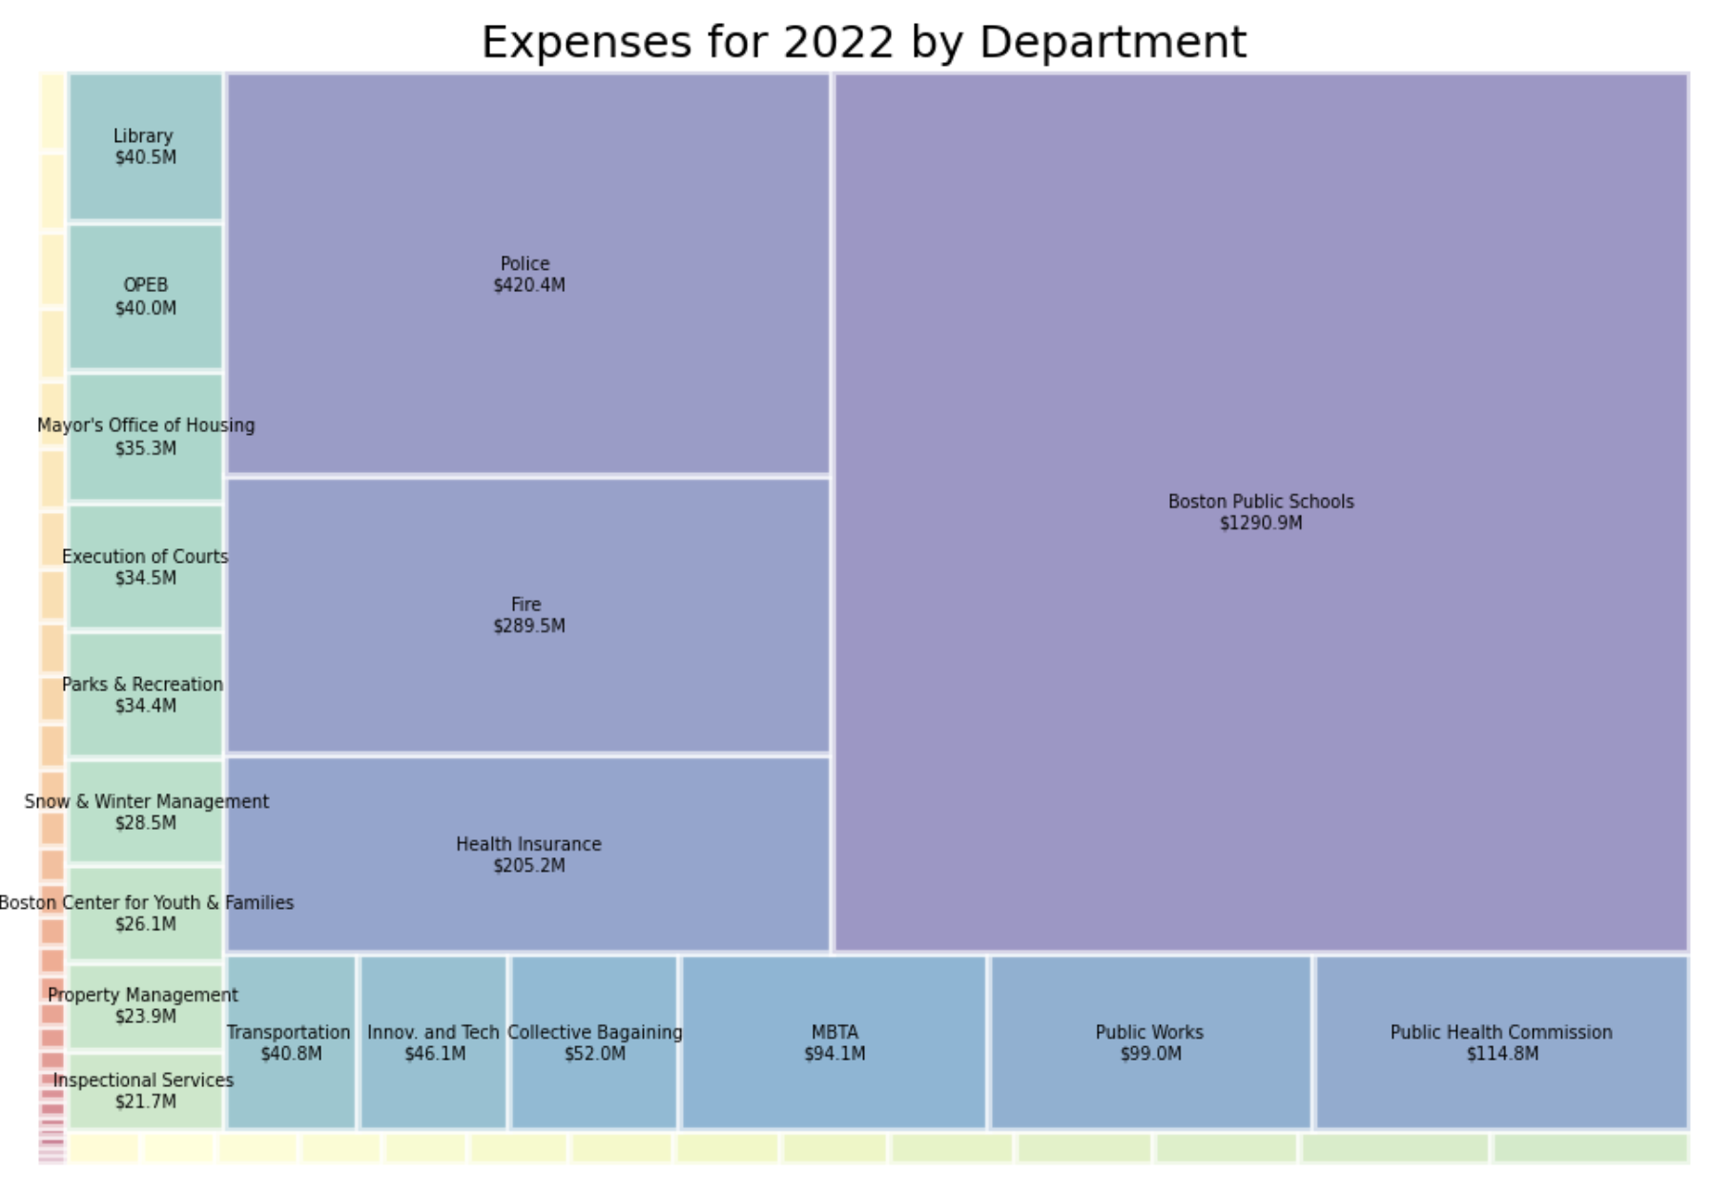
PHILADELPHIA SPENDING BY DEPARTMENT
PHILADELPHIA
BOSTON
Notes:
Jason

Slide 17
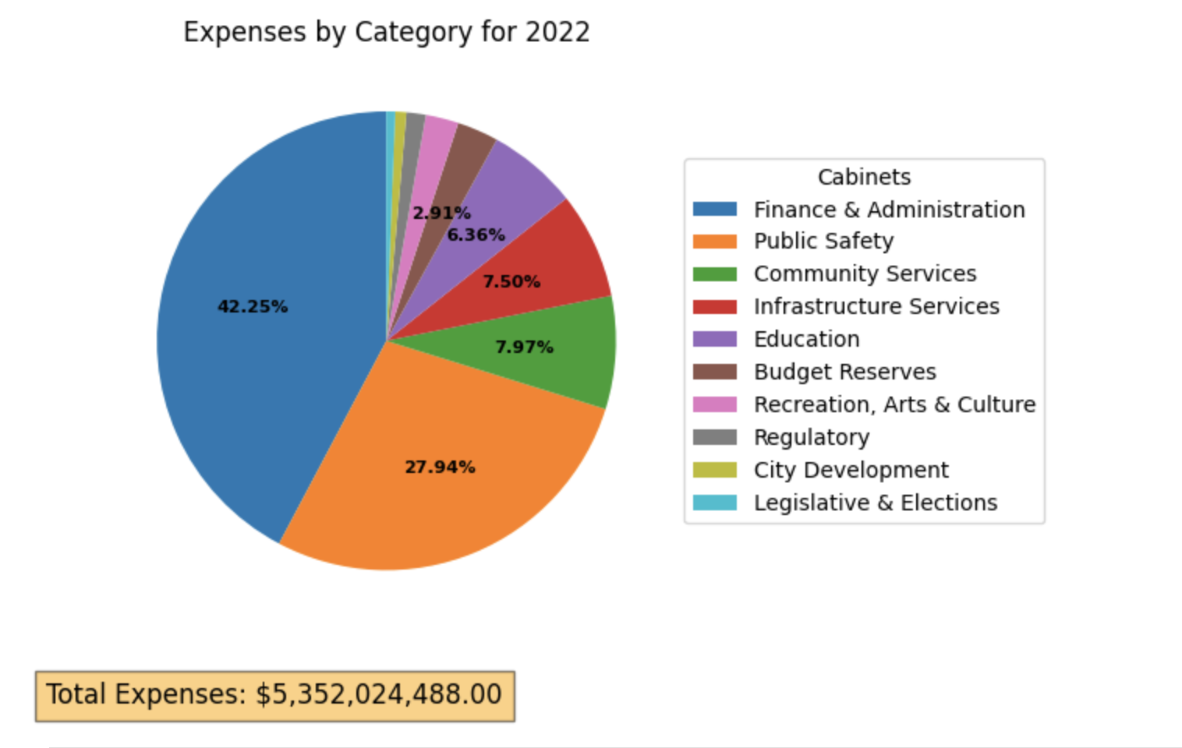
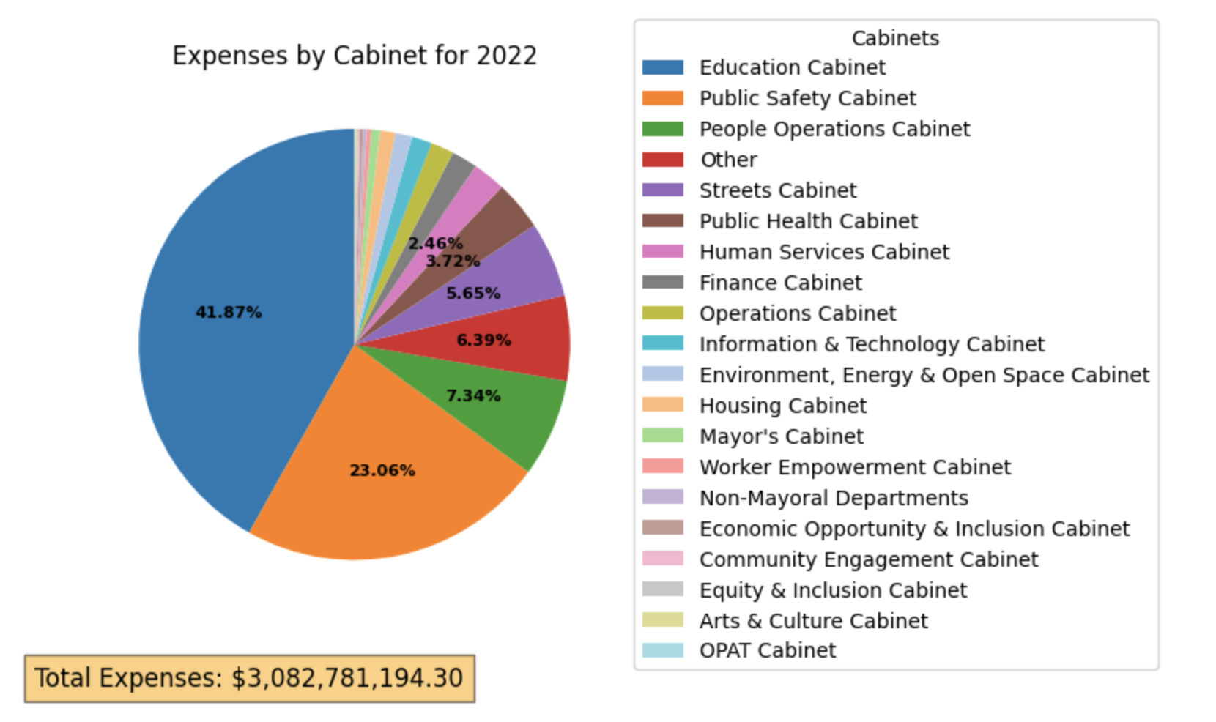
Philadelphia spending by category
PHILADELPHIA
BOSTON
Notes:
Jason

Slide 18
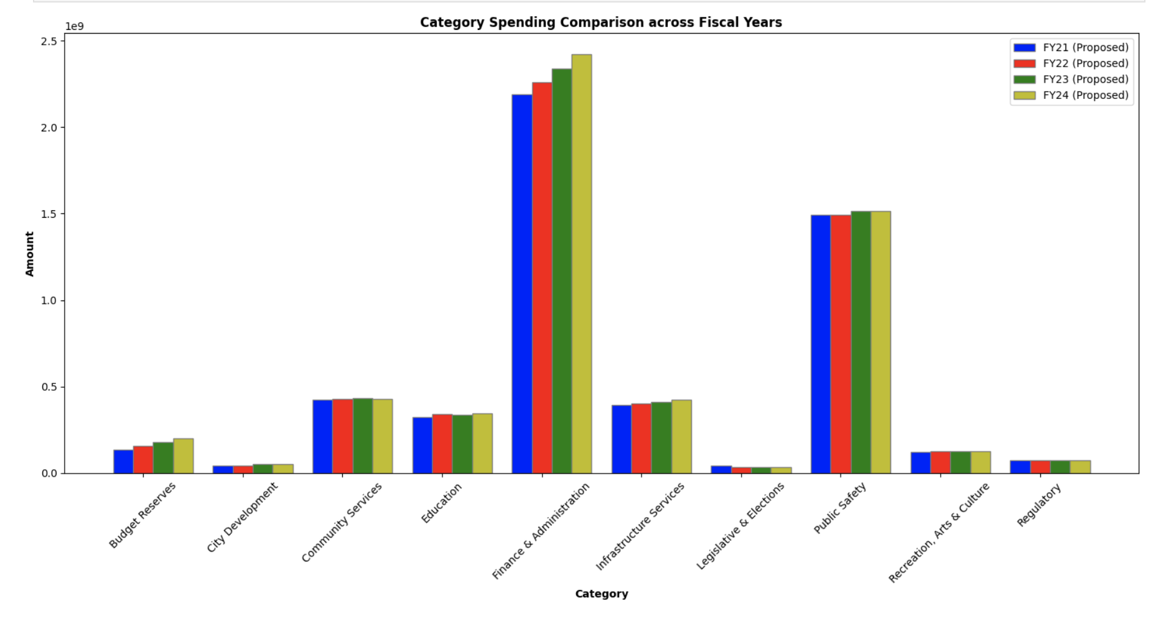
PHILADELPHIA SPENDING ACROSS YEARS(by category)
Notes:
Jason

Slide 19
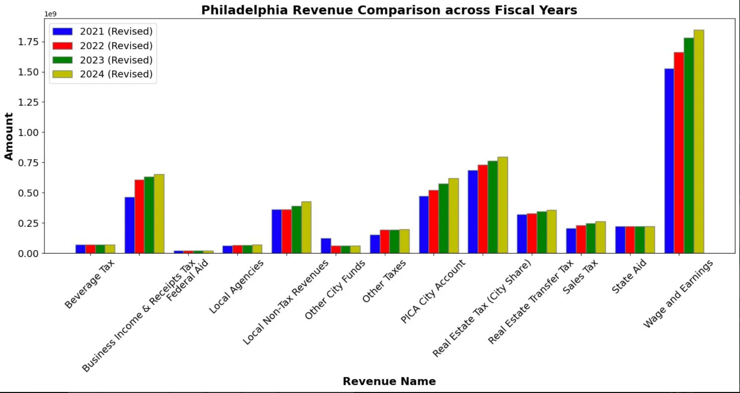
PHILADELPHIA REVENUE

Slide 20
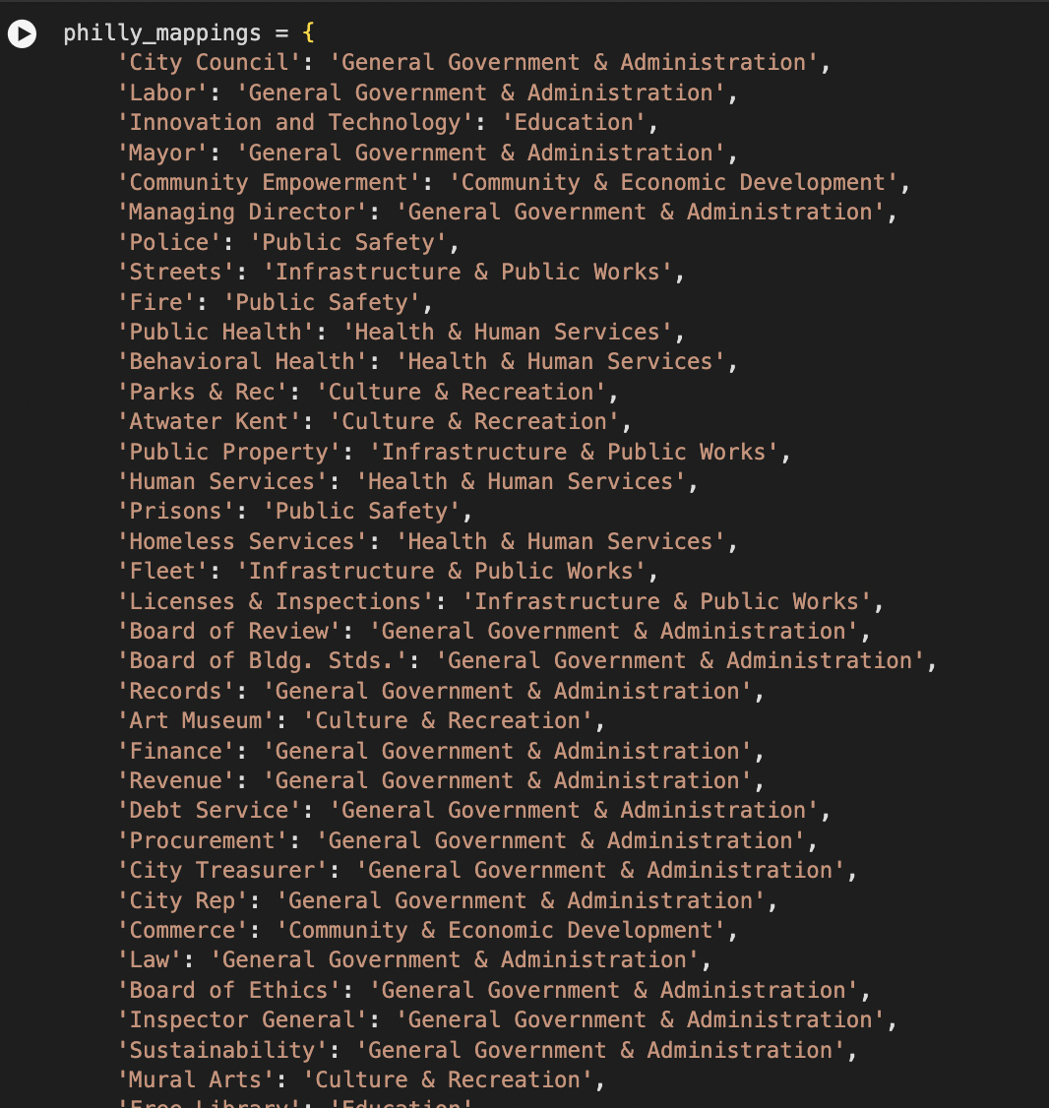
FURTHER INSIGHT INTO SPENDING CATEGORY
Public Safety
Education.
General Government & Administration
Infrastructure & Public Works
Health & Human Services
Culture & Recreation
Community & Economic Development

Slide 21
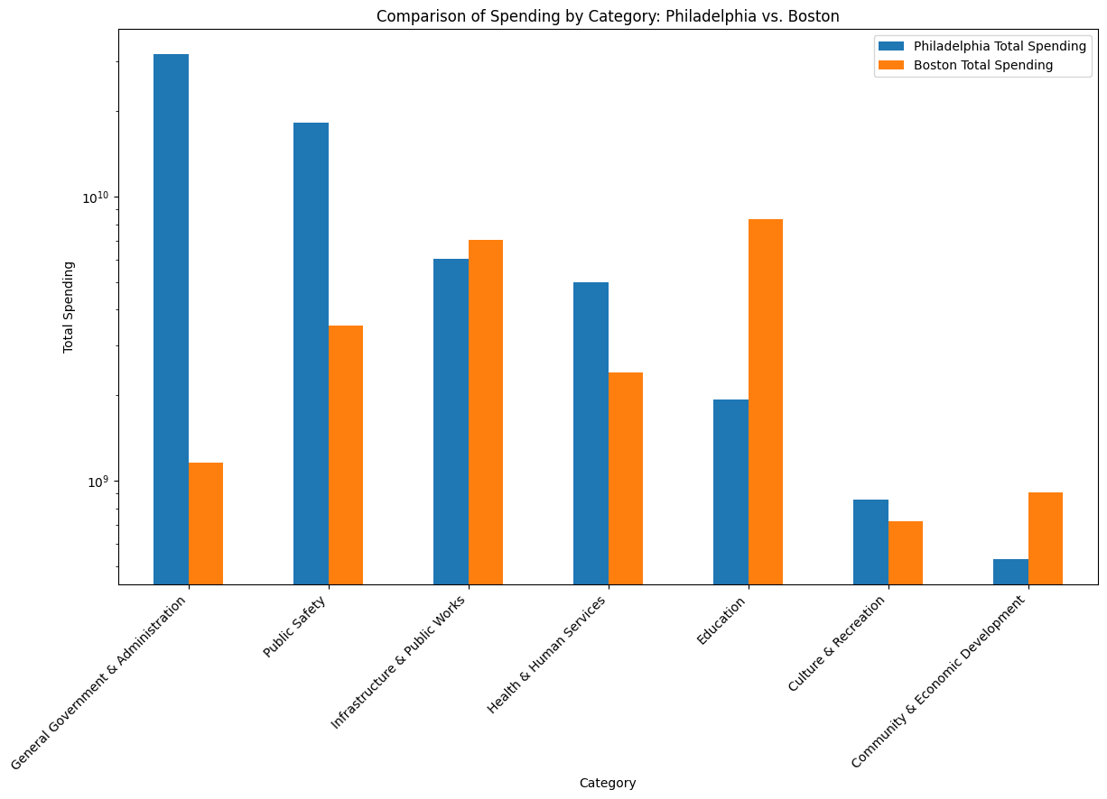
FURTHER INSIGHT INTO SPENDING CATEGORY

Slide 22
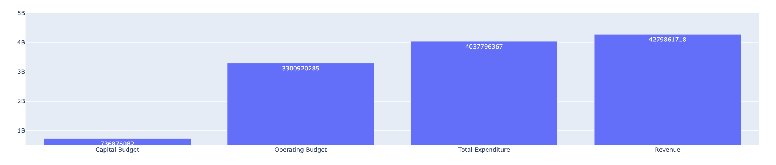
Boston spending vs revenue (2022)

Slide 23
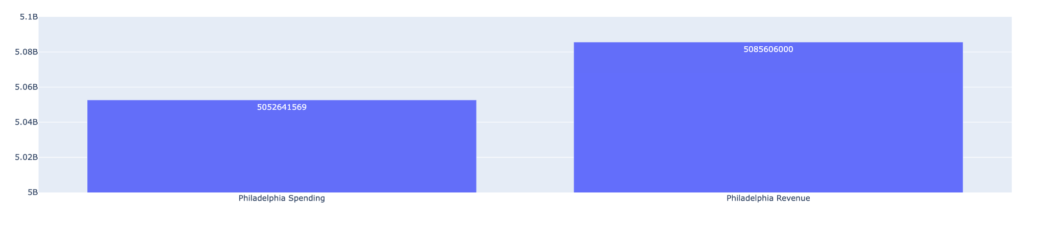
PHILADELPHIA SPENDING VS REVENUE (2022)

Slide 24
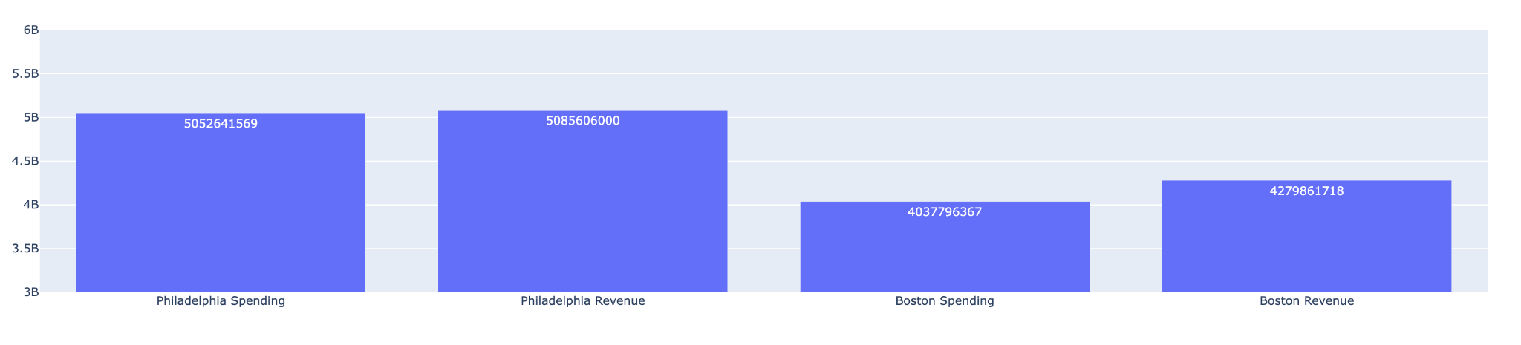
COMPARISON - Spending & Revenue (2022)

Slide 25
5.3%(5.9 VS .6)
BOSTON CITY IS MORE PROFITABLE (BETTER AT FINANCIAL MANAGEMENT) THAN PHILADELPHIA

Slide 26
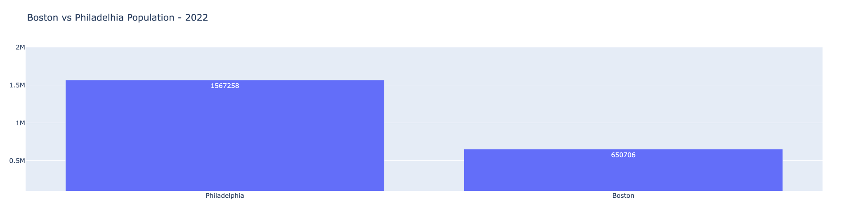
PHILADELPHIA VS BOSTON POPULATION (2022)

Slide 27
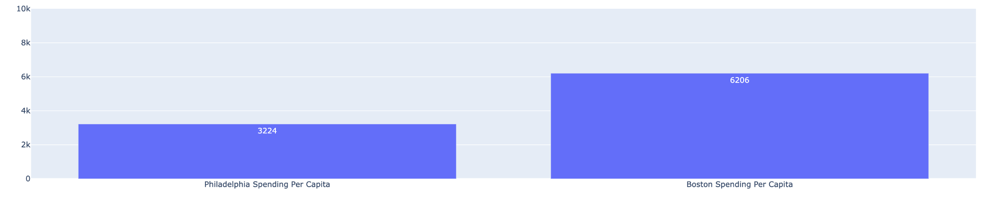
COMPARISON - Spending per capita

Slide 28
2982
BOSTON CITY SPENDS THIS MUCH MORE PER CAPITA THAN PHILADELPHIA

Slide 29
SOCIO-ECONOMIC ANALYSIS

Slide 30
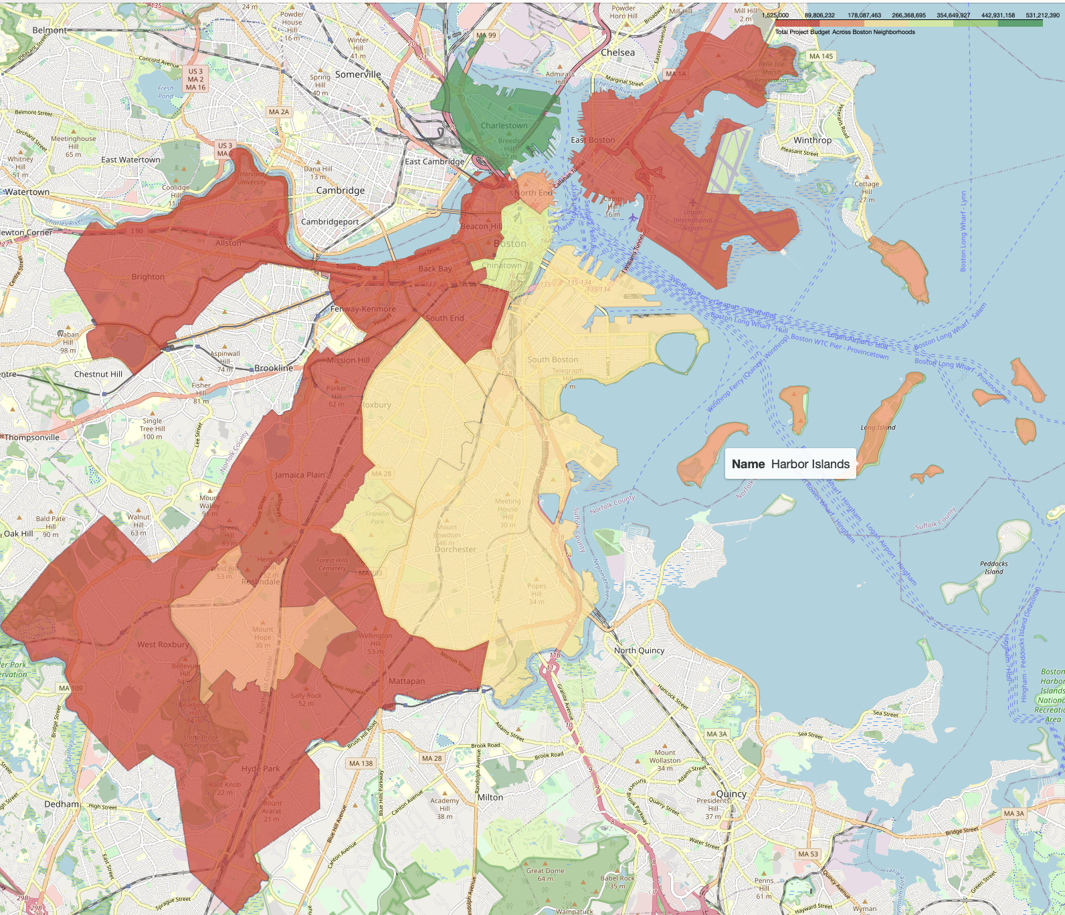
MAP REPRESENTATION OF CAPITAL BUDGET BY NEIGHBORHOOD

Slide 31
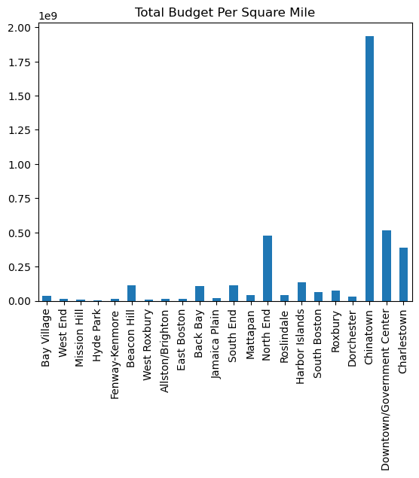
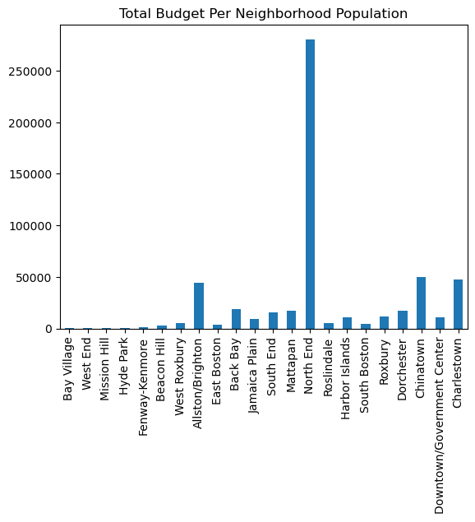
Exploring effects of area and population

Slide 32
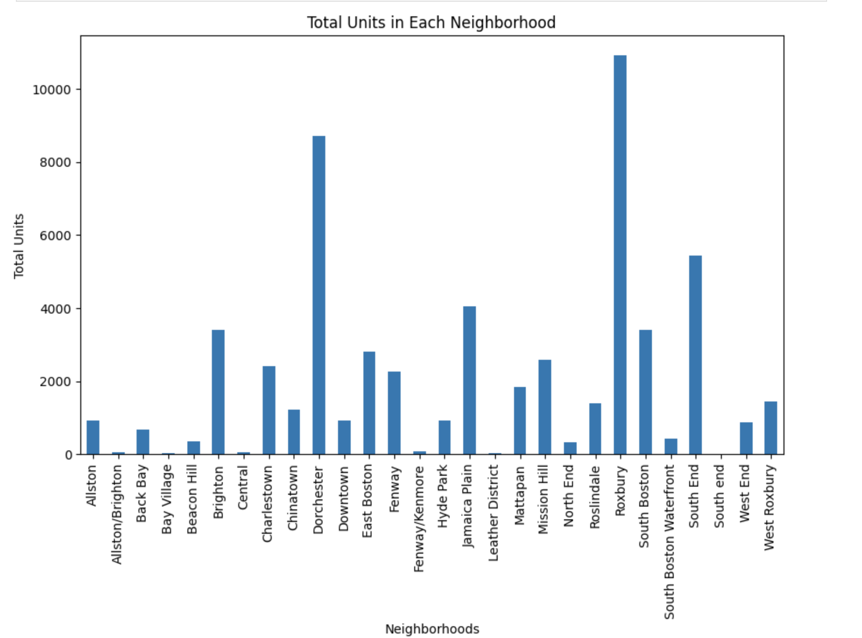
SOCIO ECONOMIC DATA

Slide 33
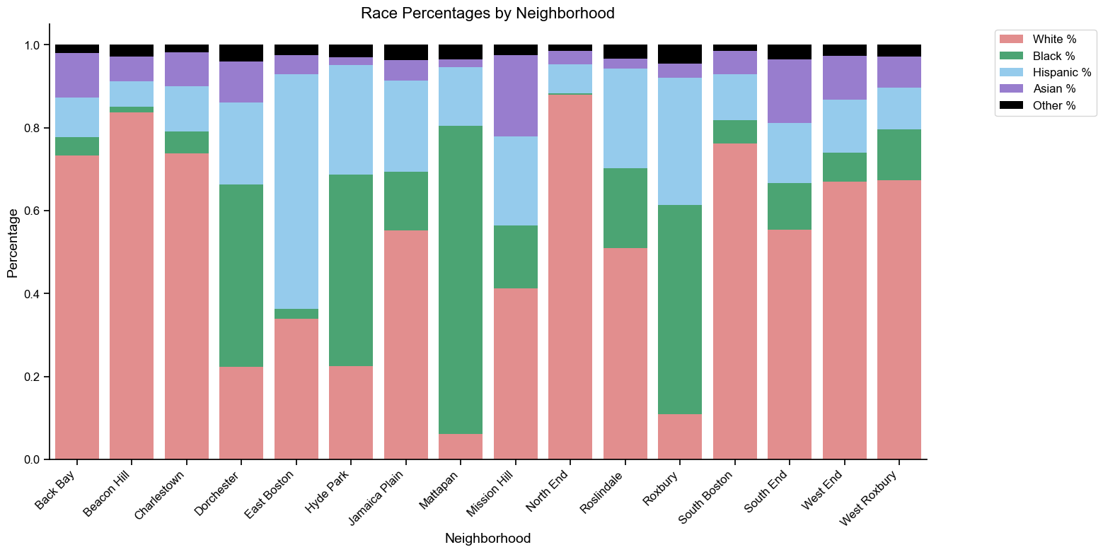
RACIAL DISTRIBUTION BY NEIGHBOURHOOD

Slide 34
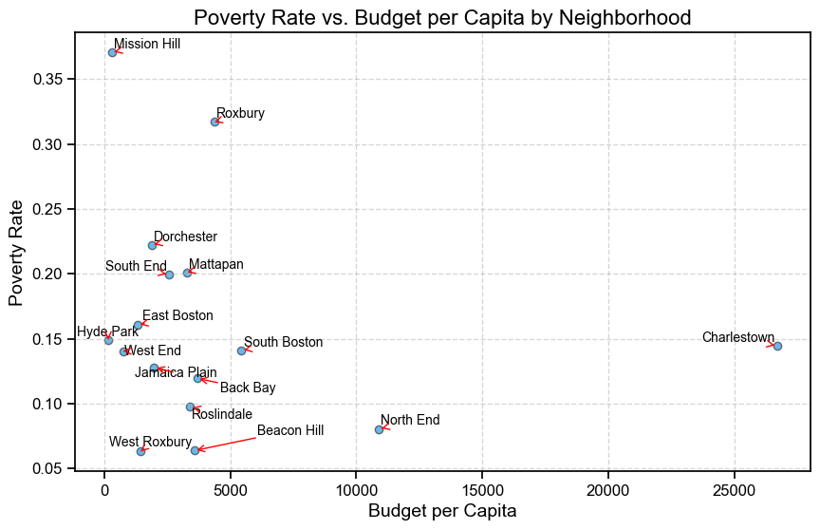
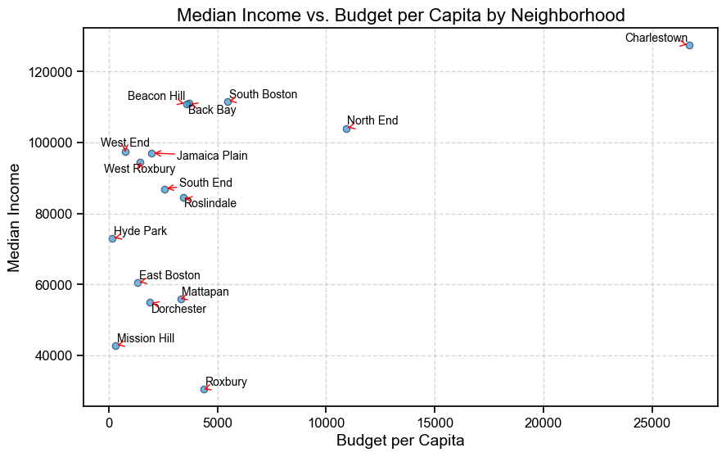
BUDGET PER CAPITA VS POVERTY RATE & MEDIAN INCOME

Slide 35
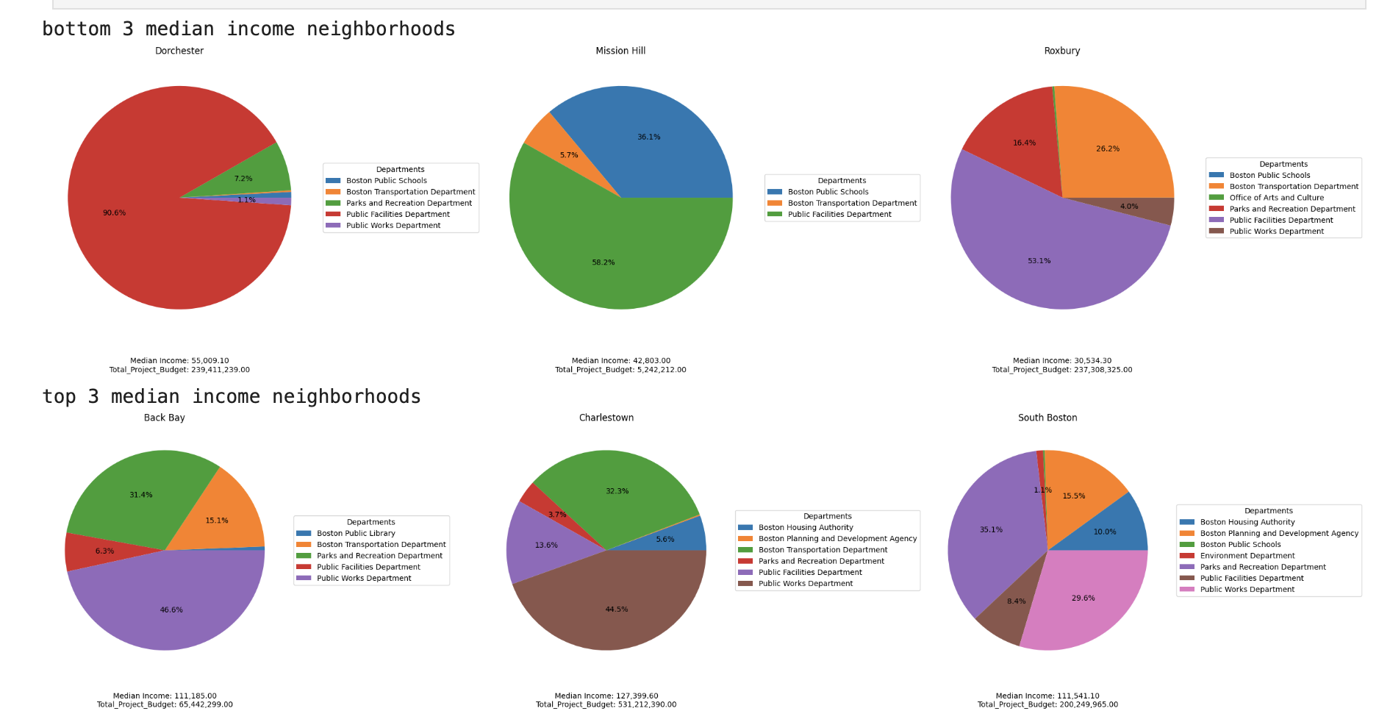

Slide 36
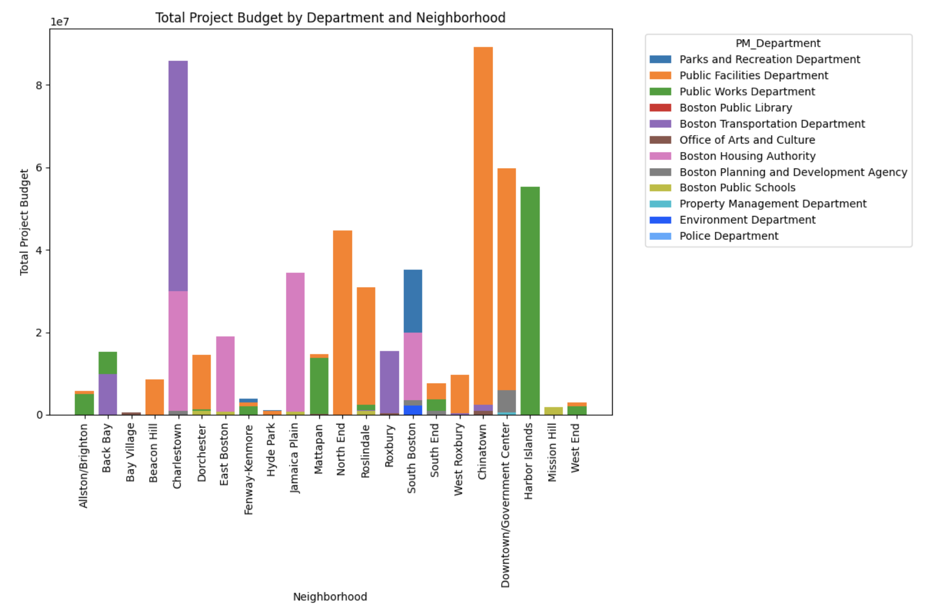
PROJECTS IN VARIOUS NEIGHBORHOODS

Slide 37
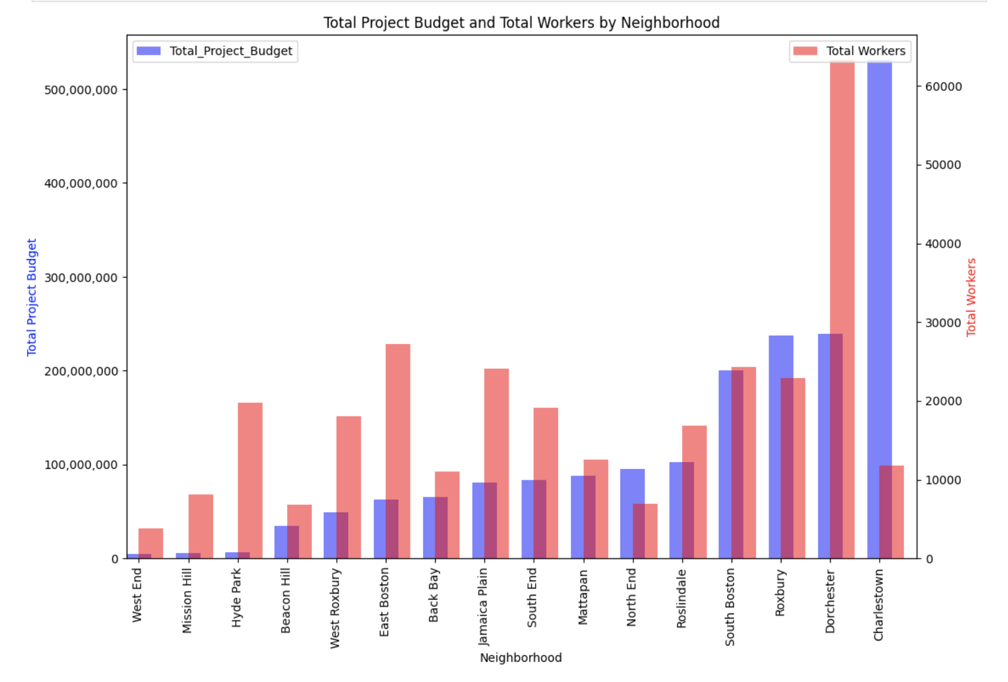
Checking if number of workers in a neighborhood influences budget

Slide 38
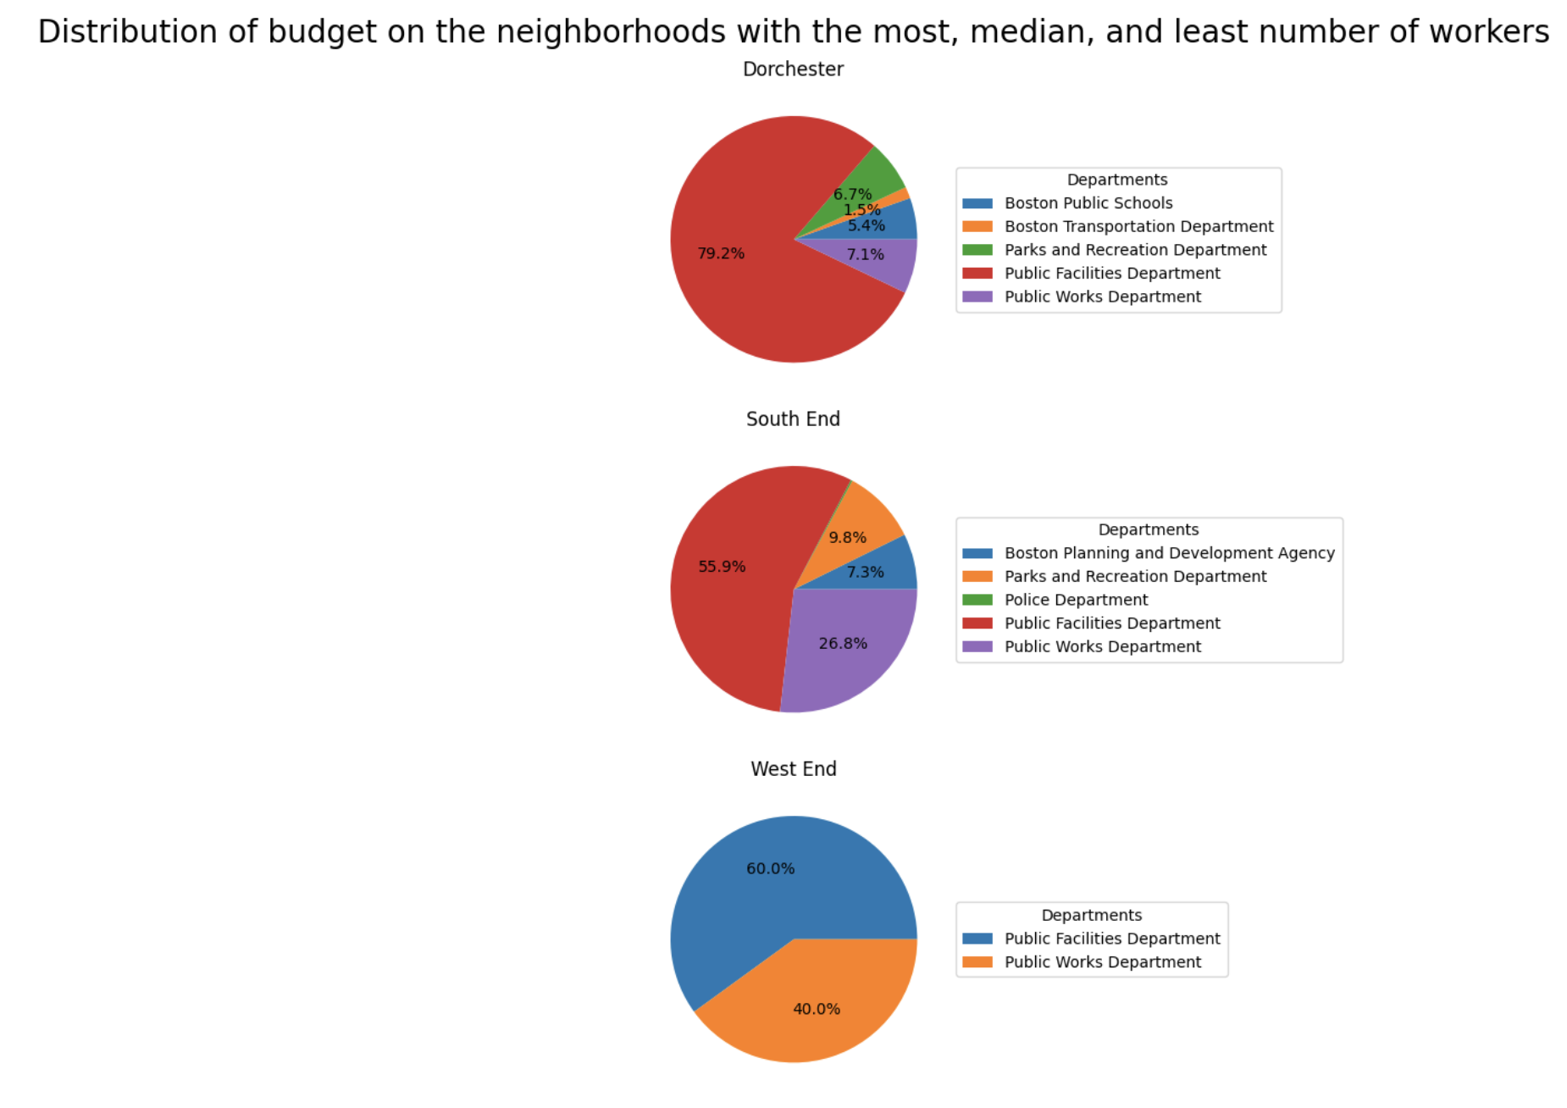

Slide 39
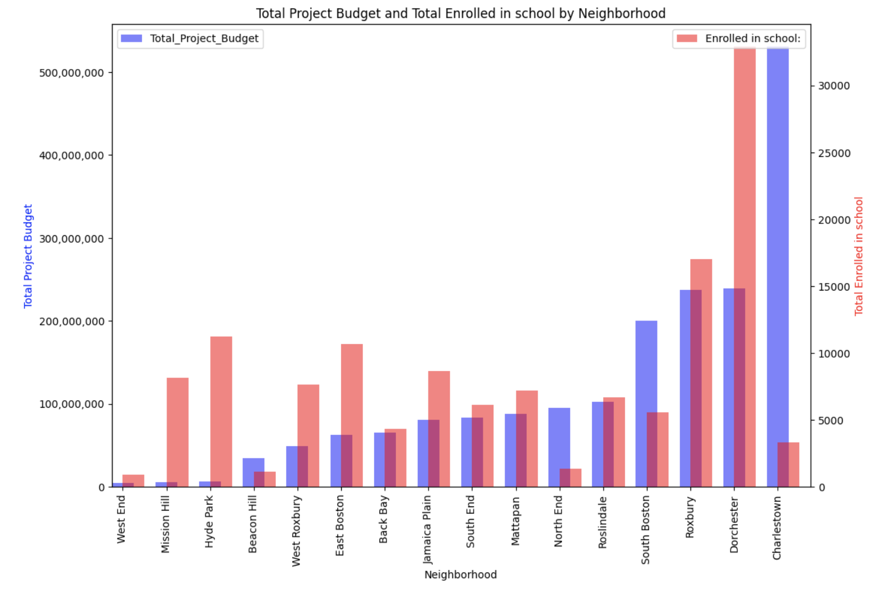
CHECKING INFLUENCE OF NUMBER OF PEOPLE ENROLLED IN SCHOOLS

Slide 40
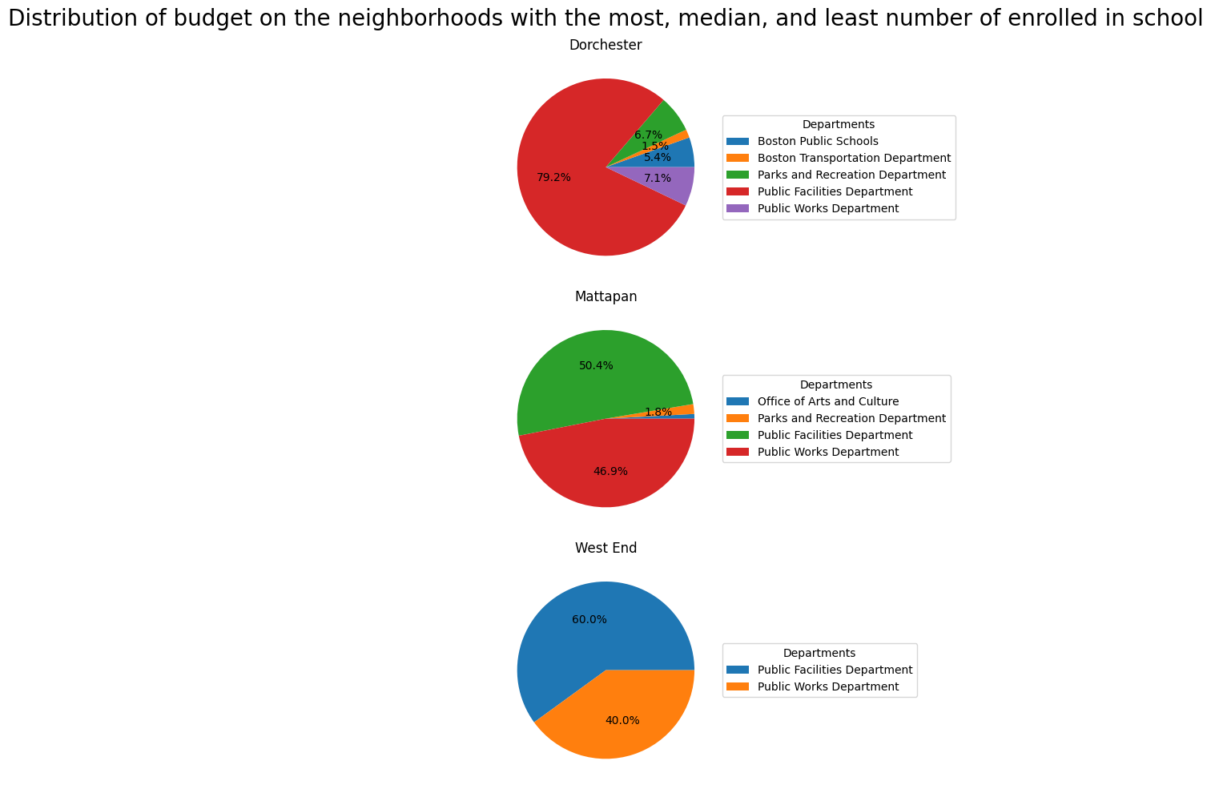

Slide 41
PLANNED NEXT STEPS
Explore impact of Revenue on Budget allocated to a department
Map departments that come under various cabinets
Finish the revenue and socio-economic extension projects
Find other ways to compare the Spending and Revenue distribution between Boston and Philadelphia

Slide 42
THANK YOU!

